Slide 1
TimeSheet Downlaoder
Jan Vaško

Slide 2
Aim
This program was developed to make TimeSheet administration easier and harmonize it over all

Slide 3
Settup

Slide 4



Callendar - Pre-Requisit
There must be special Events created for each day
Work Start → tell program when is particular working day starts
Work End → tell program when is particular working day ends
Launch → tell program when is particular launch is

Slide 5
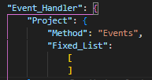
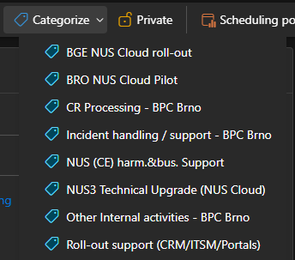
Callendar - Pre-Requisit
There must be special Events created for each day
Category → is considerate as “Project” from TimeSheets
If event is marke by category, then whole program counts with it base on setup in .json

Slide 6
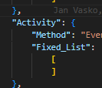
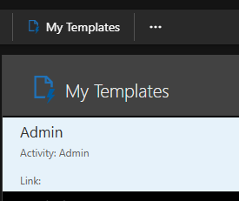
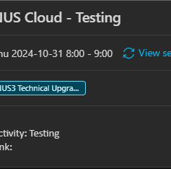
Callendar - Pre-Requisit
There must be special Events created for each day
Templates → is considerate to contain “Activity” from Timesheets
If event has line: “Activity: Activity”, then whole program counts with it base on setup in .json

Slide 7
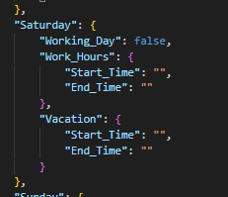
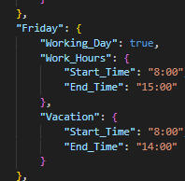
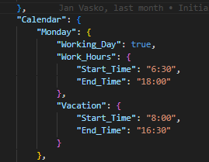

Setup .json
This .json is used as main setup for whole program and has to be maintain correctly
Personal Information
Working Hours
Vacation Hours
…

Slide 8
Downloader

Slide 9
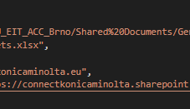
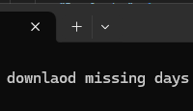
Downlaoder – Sharepoint
Program prompts at the beginning if you want to directly download missing days from Sharepoint (online) and analyze missing days
Setup data must be correctly maintained to have a correct link to proper TimeSheet Excel on Sharepoint
Authentication – first attempt is required to put password (hashed and stored)
It is required to reenter it time to time

Slide 10
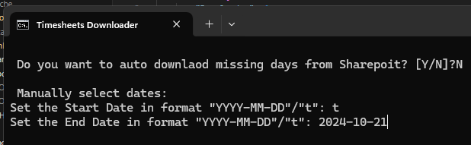
Downlaoder – Manual input
Manual input you have to select form and to dates
Format:
YYYY-MM-DD
Special: “t” = Today

Slide 11


Downlaoder - method
This first part of program is used to download events from calendar
Methods:
Outlook_classic → download data from Outlook (classic) application installed on Windows
API_Exchange_server → download events directly from Exchange Server for defined User

Slide 12
Event Handlers

Slide 13
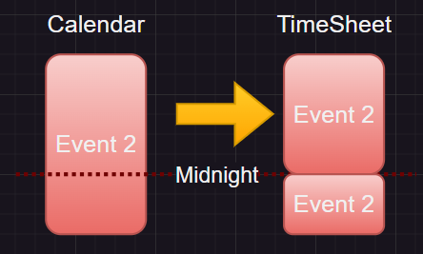
Events – OverNight
This handler splits Events if they go over night
This doest require any setup as it is programmed.
Videly used for multiday Vacation, travel-time

Slide 14
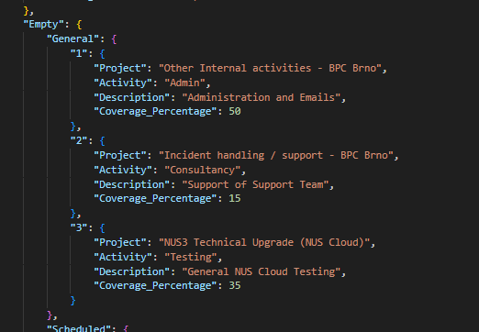
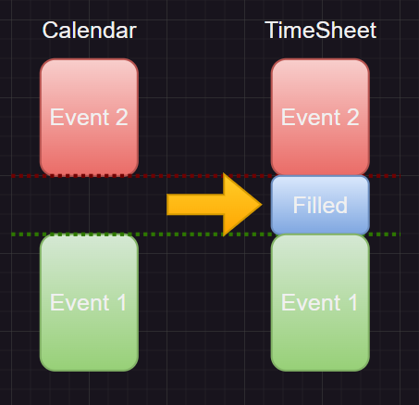
Events – Empty: General
This is for filling empty space in the calendar between events
Works only between “Work - Start” and “Work - End” events (only at the time when I'm at work)
It select one from the list from .json and use then coverage % to simulate real usage

Slide 15
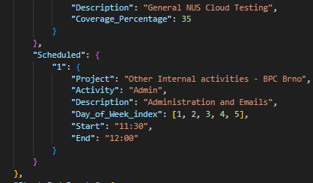
Events – Empty: Scheduled
This agenda is used for regular record planning like if I have Administration and Emails done after launch at 11:30 – 12:00
Agenda can have multiple setup (only one used on picture)
If in the period is another Event then this scheduled is not filled

Slide 16

Events – Location
Currently set for all events “Office”

Slide 17
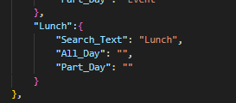
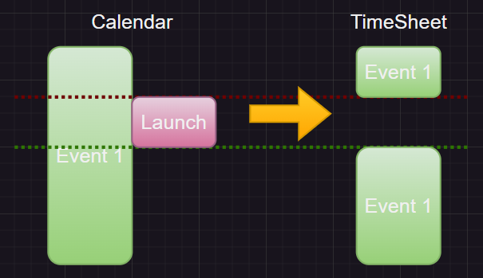
Events – Launch
Launch is special event which should be skipped from Timesheet
Also is used to split parallel meeting which is planned over the launch (like whole day meetings)
Search text can be modified in .json

Slide 18
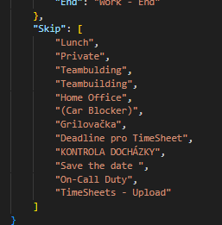
Events – Skip Events
This is the list of evens which should be skiped from registering them into TimeSheets
Can be extended in .json
Text from json is compared with Event subject and if a part of suvject contain text from .json then is recognized and event is not considerate for Time Sheets

Slide 19
Events – Parralel Events
This handler helps to process Events which might be in parallelly set in Calendar
Has 2 modes (only one can be selected in .json):
Keep_Parralel → will keep both parallel events for TimeSheet
Divide → will divide Parralle Events based on logic:

Slide 20
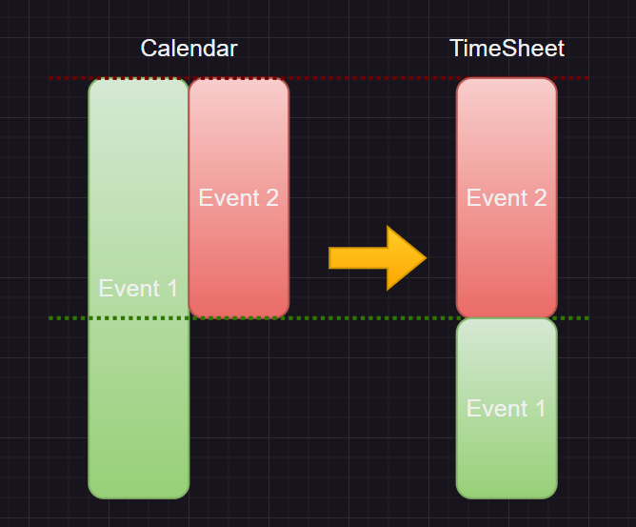
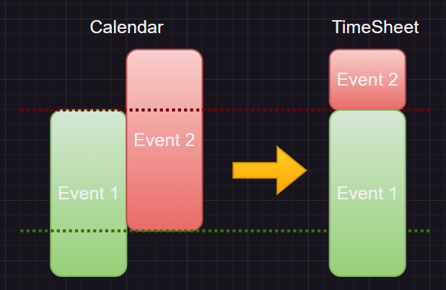
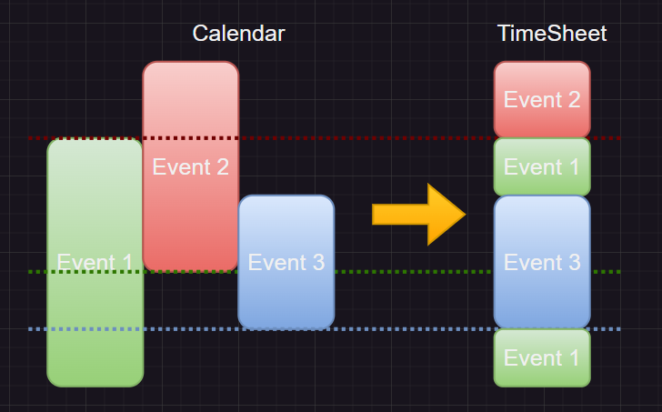
Events – Parralel Events - Logic
Here are picture of Logic used for Events Splitting

Slide 21
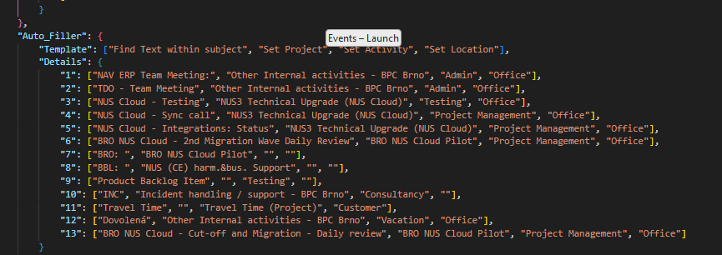
Events – AutoFiller
This special function to help automatically fill:
Project
Activity
Location
It can be enhanced in .json
If there is empty text → then is not used
As “Skip Events” program is based on searching text in the Event Subject

Slide 22
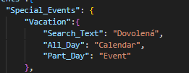
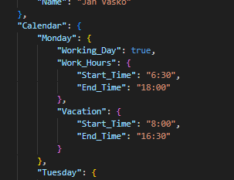
Events – Vacation
Handler of Vacation to register correctly
All day → takes hours from .json and apply them into TimeSheet
Half Day → uses only the time defined by Event
If the text appeared (defined by OKBase) in the event Subject
All Events within the Vacation period and Working hours are deleted

Slide 23
Events – HomeOffice
Currently is not maintaining anything as HomeOffice is not used as special Location of TimeSheets

Slide 24
Events - Summary
Is defined to print statistic of selected period to provide better overview of Time spent:
Total Statistics
Project Statistics
Activity Statistics
WeekDay Statistics
Week Statistics
Also print all lines before export to .csv
Open .csv in the format read to “Copy + Paste” to TimeSheet on Sharepoint

Slide 25
Upload

Slide 26
Upload – auto upload to Shareopint
Under Development now

